Slide 1
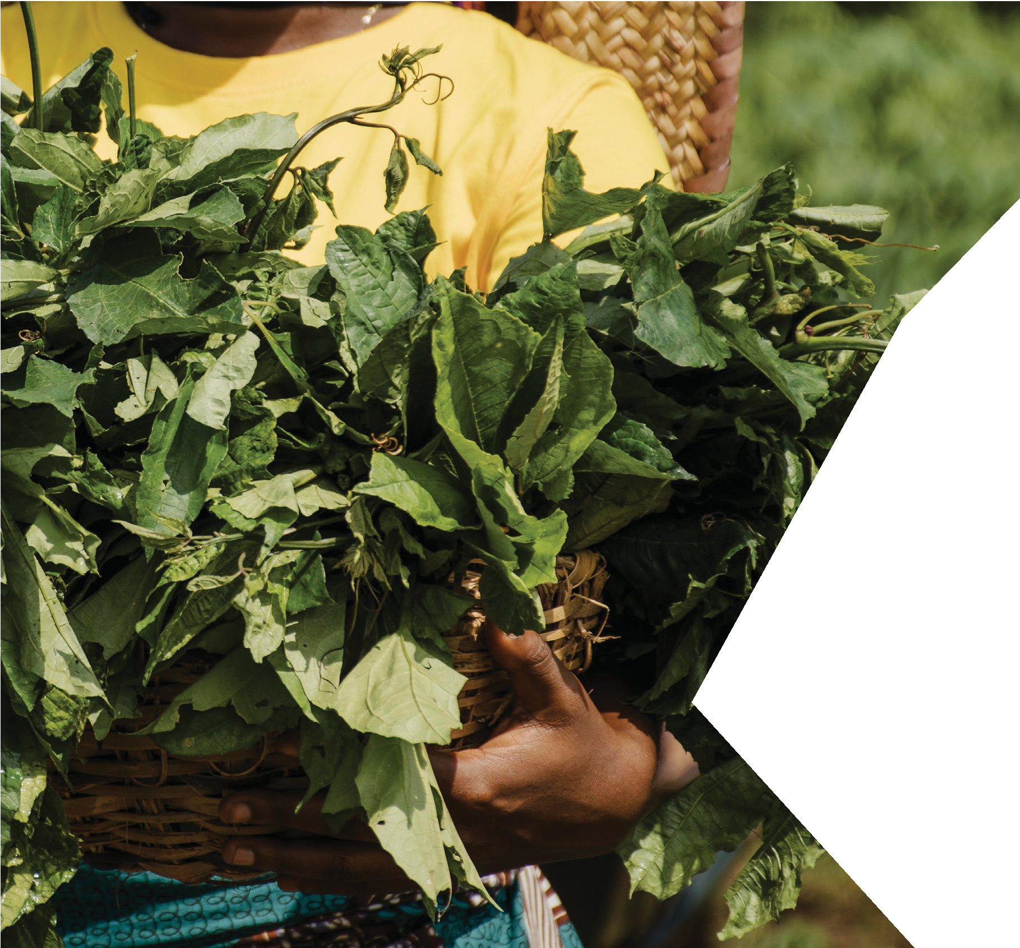

FAMA
FOOD AND MICROBIOTA IN AFRICA
The Use and Revitalization of Traditional Dishes in Dakar
Perceptions of the Link Between Traditional Diet and Health
Moustapha SEYE, Social Anthropologist, Researcher at LARTES-IFAN/UCAD
University of the Western Cape, June 30, 2026

Slide 2


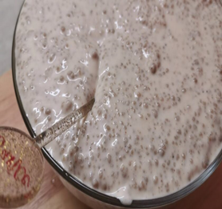
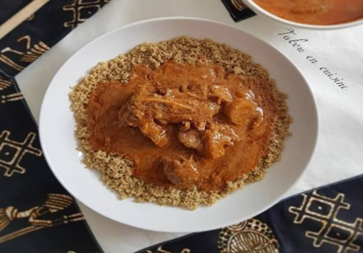
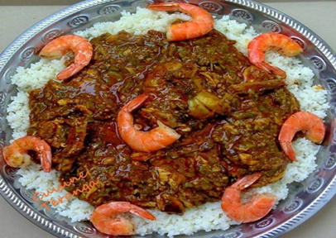
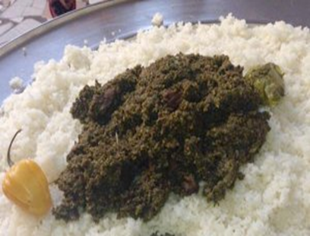
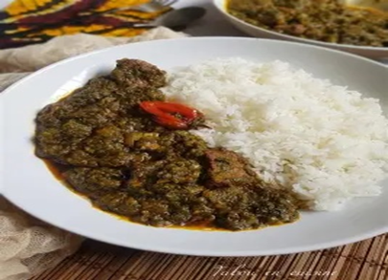
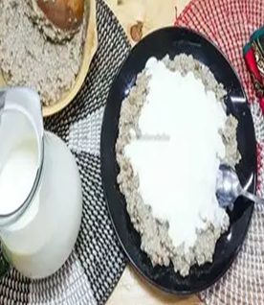
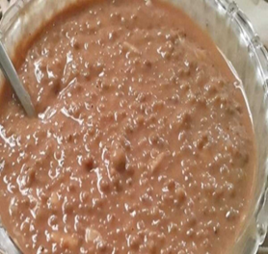
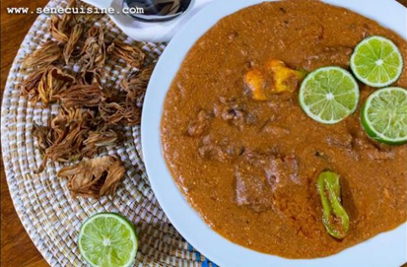
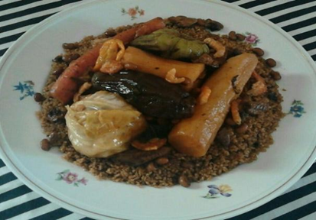
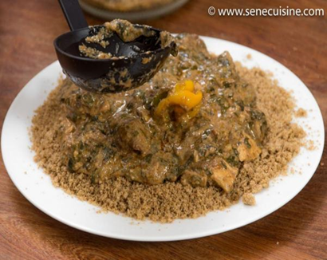
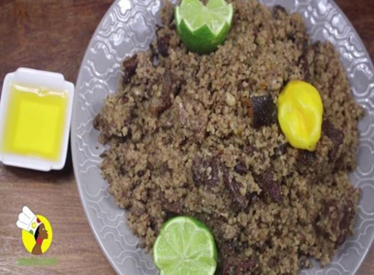
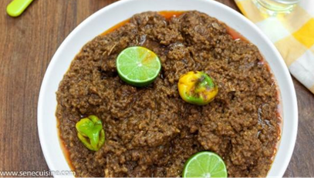
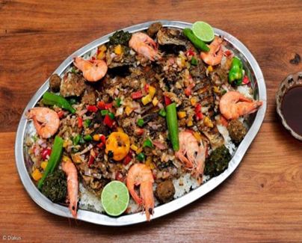
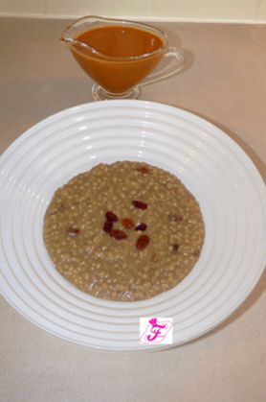
FAMAIN AFRICA
FAMAIN AFRICA
FOOD AND
MICROBIOTA
Background & Rationale
FAMA Closing Workshop, June 30, 2026

Slide 3
FAMAIN AFRICA
FAMAIN AFRICA
FOOD AND
MICROBIOTA
Background & Rationale
Rapid dietary transition: In sub-Saharan Africa, rapid urbanization is accompanied by a sharp increase in ultra-processed foods high in salt, sugar, and fat, at the expense of traditional local foods (WHO, 2024).
Double Burden of Malnutrition: Senegal faces both persistent malnutrition and a rapid rise in diet-related noncommunicable diseases: hypertension (31.6% in Dakar and 28.2% nationally), diabetes (7.7% in Dakar and 4.2% nationally), and obesity (STEPS 2024).
Growing awareness of the links between diet and health and a return to/revaluation of traditional dishes: In this context, dishes based on local grains, legumes, and regional produce are increasingly viewed as healthier, more natural, and culturally rooted alternatives (FAO, 2010).
A national priority: Senegal does not yet have formalized national dietary guidelines. The revival of traditional dishes is therefore part of a broader effort toward food sovereignty and support for local production.
FAMA Closing Workshop, June 30, 2026

Slide 4
FAMAIN AFRICA
FAMAIN AFRICA
FOOD AND
MICROBIOTA
Objectives & Hypothesis
General Objective: To identify the determinants and explanatory factors behind the consumption and revival of traditional dishes in Dakar.
Specific Objective 1: Analyze public perceptions of a traditional dish,
Specific Objective 2: Describe the most commonly consumed traditional dishes in the urban and peri-urban areas of Dakar.
Specific Objective 3: To understand the link between the consumption of traditional dishes and consumers’ health concerns.
Hypothesis: A positive perception of the link between traditional food and health is the main driver behind the renewed appreciation of these dishes.
FAMA Closing Workshop June 30, 2026

Slide 5
FAMAIN AFRICA
FAMAIN AFRICA
FOOD AND
MICROBIOTA
Methodology & Data
Mixed-methods approach: The study combines a quantitative survey with a qualitative survey, allowing for the cross-referencing of numerical data with testimonials and observations to enable more in-depth analyses. The survey was conducted among 464 individuals.
Quantitative component: 408 consumers surveyed (181 in urban areas, 227 in suburban areas) using a structured questionnaire with 8 sections, administered via CommCare. Sample size calculated using Cochran’s formula (n≈400).
Qualitative component: 4 focus groups, 34 semi-structured interviews (16 with retail outlet managers, 12 with consumers, and 6 with key informants), 6 life stories, and direct observation of retail outlets. Transcription and thematic analysis were conducted using NVivo 15.
Areas & data collection period: Urban areas: Fann-Point E, Ouakam, Medina-Fass. Peri-urban areas: Golf, Medina Gounass, Wakhinane Nimzate. Fieldwork conducted from July 25 to February 15, 2026.
FAMA Closing Workshop June 30, 2026

Slide 6
FAMAIN AFRICA
FAMAIN AFRICA
FOOD AND
MICROBIOTA
Respondent Profile
Sample size: 408 consumers: 55.6% living in suburban areas and 44.4% in urban areas of Dakar.
Young population: More than 61% are under 36 years old. The 18–25 age group is the most represented (31.4%).
Socio-educational profile: Predominantly from the informal sector (54.7%). Educational levels: Koranic education (31.6%), elementary school (29.2%), higher education (11.8%).
FAMA Closing Workshop June 30, 2026

Slide 7
FAMAIN AFRICA
FAMAIN AFRICA
FOOD AND
MICROBIOTA
Awareness of Traditional Dishes
First definition: 65.7% define a traditional dish as healthy and nutritious—this is the most common response.
Heritage and authenticity: 55.6%: local culinary heritage; 25.5%: traditional methods; 23.5%: foods not industrially processed.
“…all the foods our grandparents used to eat, such as ‘mbaxal’ and ‘cere.’ They prepared all these foods with their own hands; they were very self-sufficient in that regard. Nothing was imported. Everything comes from here. If you take the example of cere, they were the ones who grew the millet, processed it into cere, or made other dishes like ‘fondé’ or ‘laax.’ These are purely traditional dishes; nothing from elsewhere is added to them.” ESS_Consumer_28years_GOLF.
FAMA Closing Workshop June 30, 2026

Slide 8
FAMAIN AFRICA
FAMAIN AFRICA
FOOD AND
MICROBIOTA
Social perceptions: Traditional dishes are well-suited to the modern lifestyle.
High acceptance: 88% consider these dishes suitable for modern life (90.3% in suburban areas, 85.1% in urban areas).
However, purchasing traditional dishes outside the home is a common practice that is firmly embedded in weekly eating habits, with a divide between moderate consumption (2 to 4 days) and frequent consumption (7 days a week).
FAMA Closing Workshop June 30, 2026

Slide 9
FAMAIN AFRICA
FAMAIN AFRICA
FOOD AND
MICROBIOTA
Traditional homemade dishes are more popular among consumers. The ability to control the use of condiments and broths considered harmful is the main reason for this.
Preference for home-cooked meals: 77.3% prefer home-cooked meals (83.3% in suburban areas, 69.8% in urban areas).
“I prefer homemade meals because I know exactly how to prepare them and I avoid using industrial bouillon cubes. However, my schedule means I have to eat at this restaurant three or four times a week, since the distance between my home in the suburbs and my workplace in Point E makes it impossible for me to eat my own meals.” ESS_Consumer_42_Point E.
FAMA Closing Workshop June 30, 2026

Slide 10
FAMAIN AFRICA
FAMAIN AFRICA
FOOD AND
MICROBIOTA
Physical accessibility to traditional dishes is an important factor in their consumption and revitalization.
Overall availability is good: 26.5% find these dishes very accessible, and about 50% consider them fairly accessible.
Availability varies depending on the dish
« Some traditional dishes are readily available. We can find Cere, Fonde Dougoum (made with millet), Fonde Mbokk (made with maize) and Lax wherever we like, and they’re affordable. However, I’m not a ngurban seller. You can’t get it without ordering it in advance. »
ESS_Consumer_70years_Golf.
FAMA Closing Workshop, June 30, 2026

Slide 11
FAMAIN AFRICA
FAMAIN AFRICA
FOOD AND
MICROBIOTA
The desire for better health is the main motivation for consuming traditional foods.
FAMA Closing Workshop, June 30, 2026

Slide 12
FAMAIN AFRICA
FAMAIN AFRICA
FOOD AND
MICROBIOTA
Traditional dishes are believed to have both therapeutic and preventive benefits for certain diseases. 1/2
Recognized medicinal properties: The majority of respondents acknowledge that these dishes have curative and preventive properties, incorporating them into their daily health routines.
Saka-saka leads the way: Cited by 89% for its curative effects and by more than 90% for its preventive effects, it is the dish most closely associated with health.
Ngourbane: This hibiscus-based remedy is recognized for treating fatigue and malaria. Some consumers use it after illnesses related to an unbalanced diet.
FAMA Closing Workshop June 30, 2026

Slide 13
FAMAIN AFRICA
FAMAIN AFRICA
FOOD AND
MICROBIOTA
Traditional dishes are believed to have both therapeutic and preventive benefits for certain diseases. 2/2
FAMA Closing Workshop, June 30, 2026

Slide 14
FAMAIN AFRICA
FAMAIN AFRICA
FOOD AND
MICROBIOTA
Conclusion
Perceptions of traditional dishes are strongly influenced by concerns about health and nutrition.
Health concerns related to a lack of control over potential additives (such as broths or high salt content) lead people to prefer eating at home.
The health, nutritional, and digestive benefits should be highlighted to promote traditional dishes.
In the face of rising rates of diet-related diseases, traditional dishes offer an alternative to fast food and foods that are too high in fat, sugar, or salt.
FAMA Closing Workshop, June 30, 2026

Slide 15
FAMAIN AFRICA
FAMAIN AFRICA
FOOD AND
MICROBIOTA
Recommendations: Perspectives for sustaining the trend toward the revitalization of traditional dishes 1/2
FAMA Closing Workshop, June 30, 2026

Slide 16
FAMAIN AFRICA
FAMAIN AFRICA
FOOD AND
MICROBIOTA
Recommendations: Strategies for Sustaining the Trend Toward Revitalizing Traditional Dishes 2/2
Food Education: Raise awareness among young people, families, and schools about the nutritional, cultural, and identity-related benefits of traditional Senegalese dishes.
Adaptation to Urban Lifestyles: Develop simplified or semi-prepared versions and improve preservation techniques to facilitate their integration into modern households.
Nutritional Enhancement: Reduce the use of industrial broths, create nutritionally optimized variations, and align recipes with current health recommendations.
Support for local supply chains: Support local grain farmers, artisanal processors, and restaurant owners through training, financing, and improved collective organization, and integrate these dishes into public food services (school cafeterias, military, universities, etc.).
FAMA Closing Workshop, June 30, 2026

Slide 17


FAMAIN AFRICA
Moustapha SEYE
Bintou Oumaya Bâ
Abdou Majid Rabiou
FOOD AND
MICROBIOTA
THANK YOU

